Slide 1
《英语国家社会与文化入门》(下册）
The Society and Culture
of Major English-Speaking Countries
An Introduction
(Book Two)

Slide 2
Canada
Unit 21 Canadian Literature

Slide 3
Quiz
Give the English and a brief explanation for the following:
1. 玛格丽特·阿特伍德
2. 现实主义文学
3. “蒙特利尔诗人小组”
4. 爱丽丝·门罗
5. 崔维新

Slide 4
Focal Points
central idea of Canadian literature
native Canadian mythology
early colonial literature
literature of nation-building
Ted Allan
Hugh Maclennan
Margaret Atwood
Margaret Laurence
Alice Munro
Michael Ondaatje
Wayson Choy

Slide 5
This Unit Is Divided into Five Sections
Introduction: the Literature of Survival
Native Canadian Mythology and Early Colonial Literature
The Literature of Nation-building
Canada in the Ascendant
Canadian Literature in the Modern World

Slide 6

I. Introduction: the Literature of Survival
The famous Canadian novelist, Margaret Atwood, points out that we should look for a central idea which appears in many different authors and works and periods. Such an idea, if found, may be thought of as a basic symbol for that national culture.

Slide 7
I. Introduction: the Literature of Survival
In Canadian literature Atwood sees a common concern with the idea of “survival” , and she says we should think of survival as the central symbol of Canadian literature. She describes many ways in which this symbol appears: a concern with “simple” survival in the face of hostile elements --the dangerous natural world in which Canadians find themselves, with huge distances to cross to get help, endless forests to get lost in, hard winters to freeze in, wild animals to attack them. Surviving in these conditions was a hard job for Canadians, native or settler, prior to the 20th century.
She says that this idea can extend to concern with “cultural” -- the attempt to maintain a Canadian identity .

Slide 8
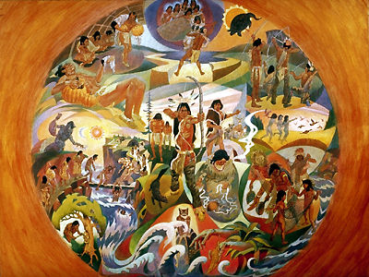
II. Native Canadian Mythology and Early Colonial Literature
Many collections of native stories have been made, some scholarly, some for general readership, some for children. Native myths and legends are a well-known part of modern Canadian literature.

Slide 9
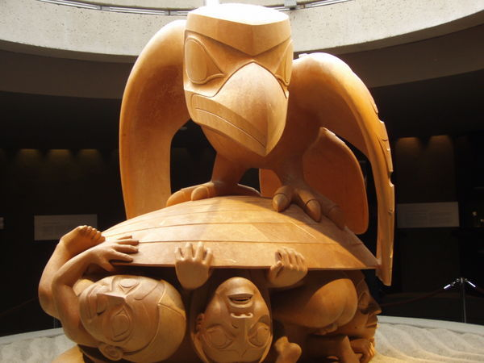
Native Canadian Mythology
The first type of native Canadian myths is about creation that describes the origins of the cosmos and the people, such as the west-coast story of how Raven found the first humans living in a clam-shell, and set them free.

Slide 10
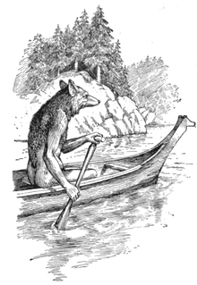
Native Canadian Mythology
A common feature of different native mythologies is the occurrence of a “trickster” figure: godlike in his powers, humanlike in his imperfections. Amongst eastern peoples this figure was seen as a coyote --a kind of wild dog.

Slide 11
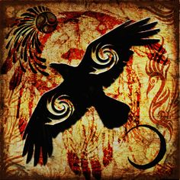
Native Canadian Mythology
In the west the trickster figure was given the identity of a raven. The cunning trickster perhaps represents the way in which life both gives and takes away. The trickster often helps human beings but sometimes only to play a joke on them --or on the gods.

Slide 12
Early Colonial Literature
Early colonial literature in Canada has been described as an era of reporting: telling people back “home” what it was like out there on the edge of civilization.
Books published in that era took the form of journals or collections of letters, which often took the “wilderness” or the native peoples as their subject.

Slide 13
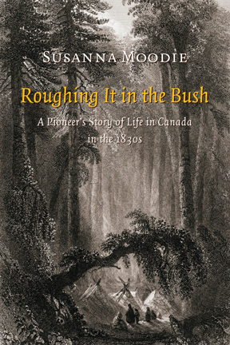
Early Colonial Literature
The book Roughing It in the Bush written by Susanna Moodie (1803-1885) would be a good example of such a description of the colonist’s experience in dealing with the harsh Canadian environment, surviving in the new world in which she found herself.

Slide 14
III. The Literature of Nation-building
After confederation in 1867 Canada was inhabited by a people on the road to nationhood. This coincided with the era in which the modern world came into being, through rapid social change which occurred initially in the West, and rapidly spread throughout the world.
In one way this process was seen as the natural, logical outcome of events.
It was also the era of realism in literature, where plots were worked out in a coherent and predictable fashion, whereby the conclusion followed rationally from what went before, though much of the actual content might be romantic fantasy.

Slide 15
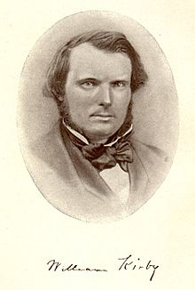
III. The Literature of Nation-building
Quebec’s difficult relationship with this nation-building process is perhaps seen in a novel like William Kirby’s The Golden Dog, a romantic historical novel set at the time of the fall of the French colony to the English, and concerning power struggles among that colony’s rulers. (Right: William Kirby, 1817-1906).

Slide 16

III. The Literature of Nation-building
Probably the most famous single work of Canadian literature, loved by readers all over the world, is the children’s story Anne of Green Gables written by Lucy Maud Montgomery (1874-1942). The author was born and raised on Prince Edward Island and the novel tells the story of a redheaded orphan girl, Anne, and her adolescent predicaments in the idyllic setting of a small island town.

Slide 17
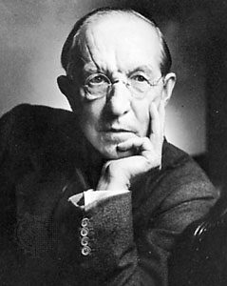
III. The Literature of Nation-building
Duncan Campbell Scott (1862-1947) was a poet and short-story writer, a member of a group known as the "confederation" poets. His very modern short stories were psychologically realistic portrayals of the citizens of a small village in Quebec. That focus on individual psychology is an indication of a change in the cultural world from the relative certainties of the late 19th century to the questioning of the 20th.

Slide 18
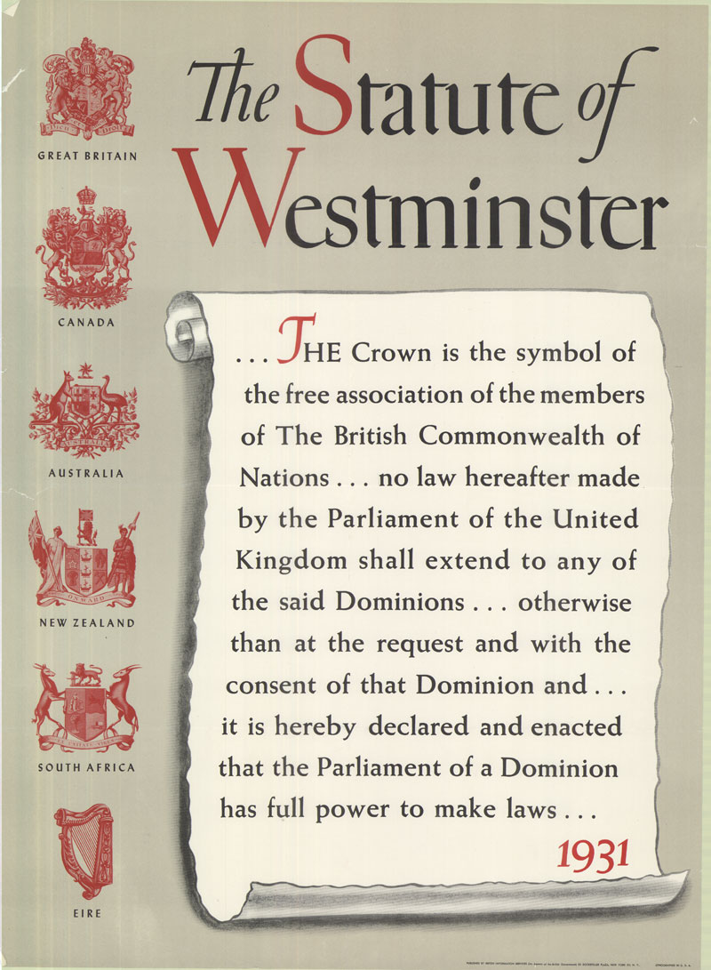
IV. Canada in the Ascendant
Though Canada had had a high degree of independence from Britain for a while, it was not really until the Statute of Westminster in 1931 that Canadian nationhood became a fact, as it took its position as an equal and vigorous nation within the voluntary association of the British Commonwealth.

Slide 19
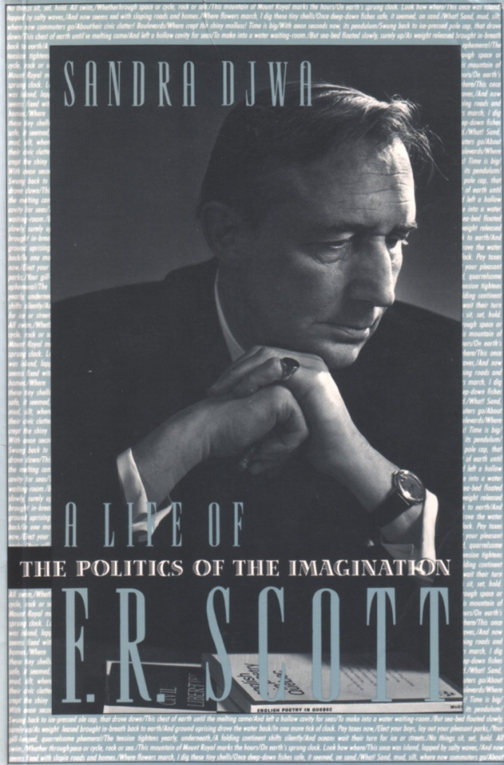
IV. Canada in the Ascendant
The Montreal Group was a circle of Canadian modernist writers formed in the mid-1920s at McGill University in Montreal, Quebec, which included Leon Edel, John Glassco, A.M. Klein, Leo Kennedy, F. R. Scott and A. J. M. Smith. The group especially championed the theory and practice of modernist poetry.

Slide 20
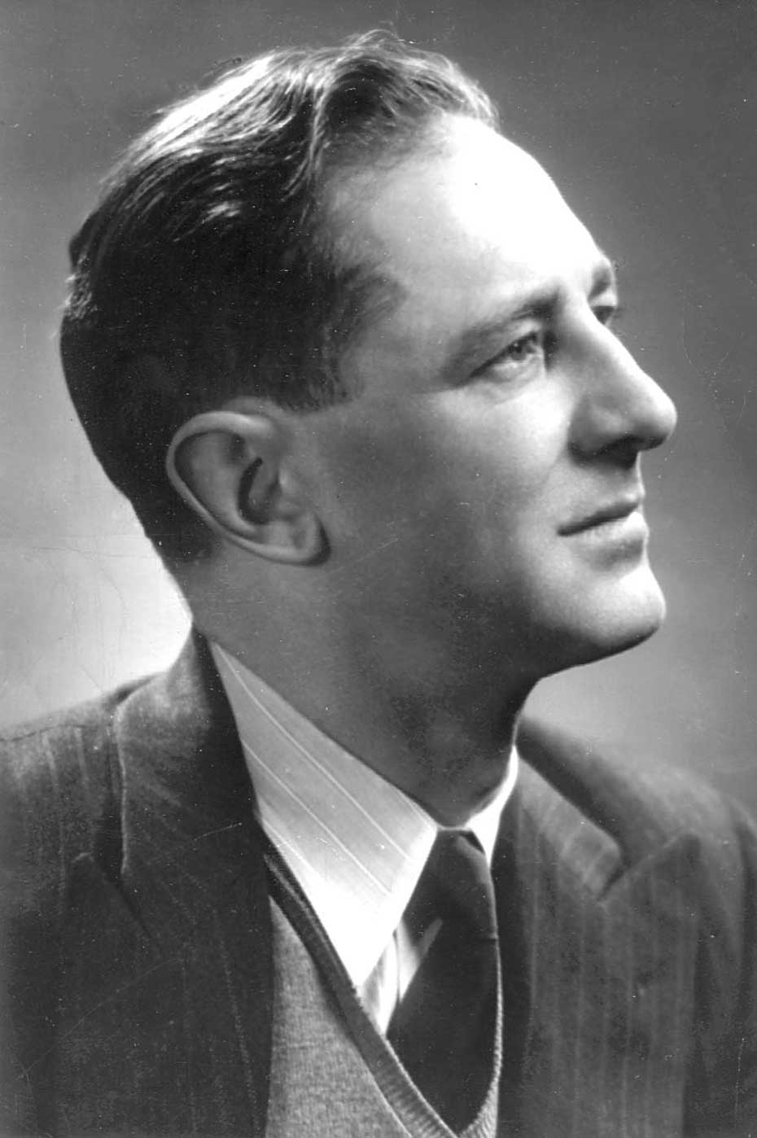
IV. Canada in the Ascendant
Hugh MacLennan (1907-1990): The relationship between French and English Canada was the subject of Hugh Maclennan’s 1945 novel The Two Solitudes, which described an English professor, whose wife is dying of cancer in a Montreal hospital. The title refers to the separateness of Canada’s two main ethnic groups.

Slide 21
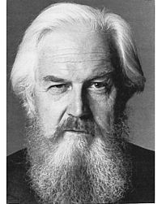
IV. Canada in the Ascendant
William Davies (1913 – 1995) was a Canadian novelist, playwright, critic, journalist, and professor. He was one of Canada's best known and most popular authors. One of his major themes is the search for one's identity and the need to justify one's existence. In his Fifth Business, the main character Dunstan Ramsay searches for a new identity by leaving his old town of Deptford.

Slide 22
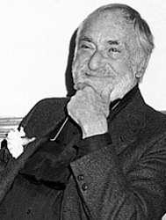
IV. Canada in the Ascendant
Ted Allan (1916-1995) wrote a novel based on his experience as a volunteer in Spain called This Time a Better Earth. He served there with another young Canadian, a doctor called Norman Bethune, and later wrote his biography The Scalpel, The Sword including the period of Bethune’s activities in China with Mao Zedong.

Slide 23
V. Canadian Literature in the Modern World
Canada’s most famous and successful writers have appeared in the post-WWII period.
Canada finished the war as a confident, wealthy and influential nation, and played a major role in building postwar international institutions.
Canadian nationhood was no longer in doubt from an outside perspective, but from the inside the nature of that nation and the strength of its institutions remained somewhat in question.
Canada’s dominant cultures were originally British and French, as well as aboriginal. After Prime Minister Trudeau’s “Announcement of the Implementation of a Policy of Multiculturalism within a Bilingual Framework,” in 1971, the country’s literature has diversified, influenced by international immigration.
Ethnic, region and gender were the topics modern Canadian literature investigated in a process of self-analysis.

Slide 24
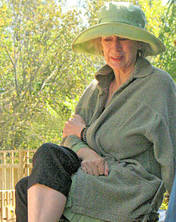
Some of the Major Canadian Writers of the Modern Period
Margaret Atwood, (1939-), is a Canadian poet, novelist, literary critic, essayist, and environmental activist. She is best known for her work as a novelist, and she has also published fifteen books of poetry. Many of her poems have been inspired by myths and fairy tales. Her major work includes Life Before Man ,The Handmaid’s Tale, Cat’s Eye, The Robber Bride, Alias Grace ,The Blind Assassin, Oryx and Brake, The Year of the Flood, and MaddAddam.

Slide 25
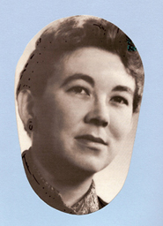
Some of the Major Canadian Writers of the Modern Period
Margaret Laurence (1926-1987) was a Canadian novelist and short story writer, and one of the major figures in Canadian literature. She effectively portrays the arrival of successive waves of settlers: Native, Scots, English, Irish, Asian, thus challenging the emphasis of Canadian culture on dealing with the "two solitudes" (French and English) and emphasizing instead a more complicated mix of cultures. Her major books include This Side Jordan, The Stone Angel, A Jest of God, and The Diviners.

Slide 26

Some of the Major Canadian Writers of the Modern Period
Margaret Laurence’s novel A Jest of God was made into a movie directed by Paul Newman, a famous American movie star, in 1968.

Slide 27
Some of the Major Canadian Writers of the Modern Period
Alice Munro (1931-)
She is a Canadian writer best known for her short stories.
She was awarded the 2013 Nobel Prize for Literature.
Her first book of short stories was published in 1968 and since then she has published fifteen more.
Her work frequently appears in magazines including The New Yorker, The Atlantic Monthly, and The Paris Review.
Her collections of short stories include Dance of the Happy Shades; Something I’ve Been Meaning to Tell You; The Progress of Love; Friend of My Youth; Open Secrets; Hateship, Friendship, Courtship, Loveship, Marriage; Runaway; and a novel, Lives of Girls and Women.
During her distinguished career she has been the recipient of many awards and prizes. Her stories have been translated into thirteen languages.

Slide 28
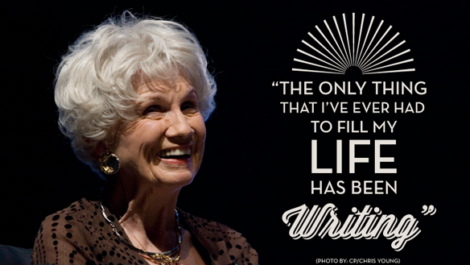
Alice Munro

Slide 29

Some of the Major Canadian Writers of the Modern Period
Michael Ondaatje (1943- ) was born in Sri Lanka, went to school in England and moved to Canada as a young man. He is best-known for his novel The English Patient set in the countries around the Mediterranean during WWII. The novel was made into a successful film in 1997. (Right: a scene from the film The English Patient.)

Slide 30

Some of the Major Canadian Writers of the Modern Period
Wayson Choy (崔維新)
(1939- ) is one of the many Chinese Canadian authors that have emerged recently. His first novel The Jade Peony was published to wide acclaim in 1995. His Paper Shadows: A Chinatown Childhood (1999) is a memoir of his Chinatown childhood. His other work includes All That Matters and Not Yet: A Memoir of Living and Almost Dying in 2009.

Slide 31
Questions for Discussion
Why is the idea of survival regarded as the central symbol of Canadian literature? What does cultural survival mean in Canadian literature?
Why has Margaret Atwood received so much attention from ecocritics?
C. What contributions has Alice Munro made to literature?
D. How is multiculturalism reflected in Canadian literature?

Slide 32
The End
高等教育出版社
2015

